Slide 1
Issue Tracker
George Leinert - AWD Fall 2022 Final Project

Slide 2
BACKGROUND
I took on this project to create something that could be useful to future employers.
From this project I learned how to make a web app using react and connecting the front and back end.
If I were to do this project again, I would spend more time on styling the front end application to make it more visually appealing.

Slide 3
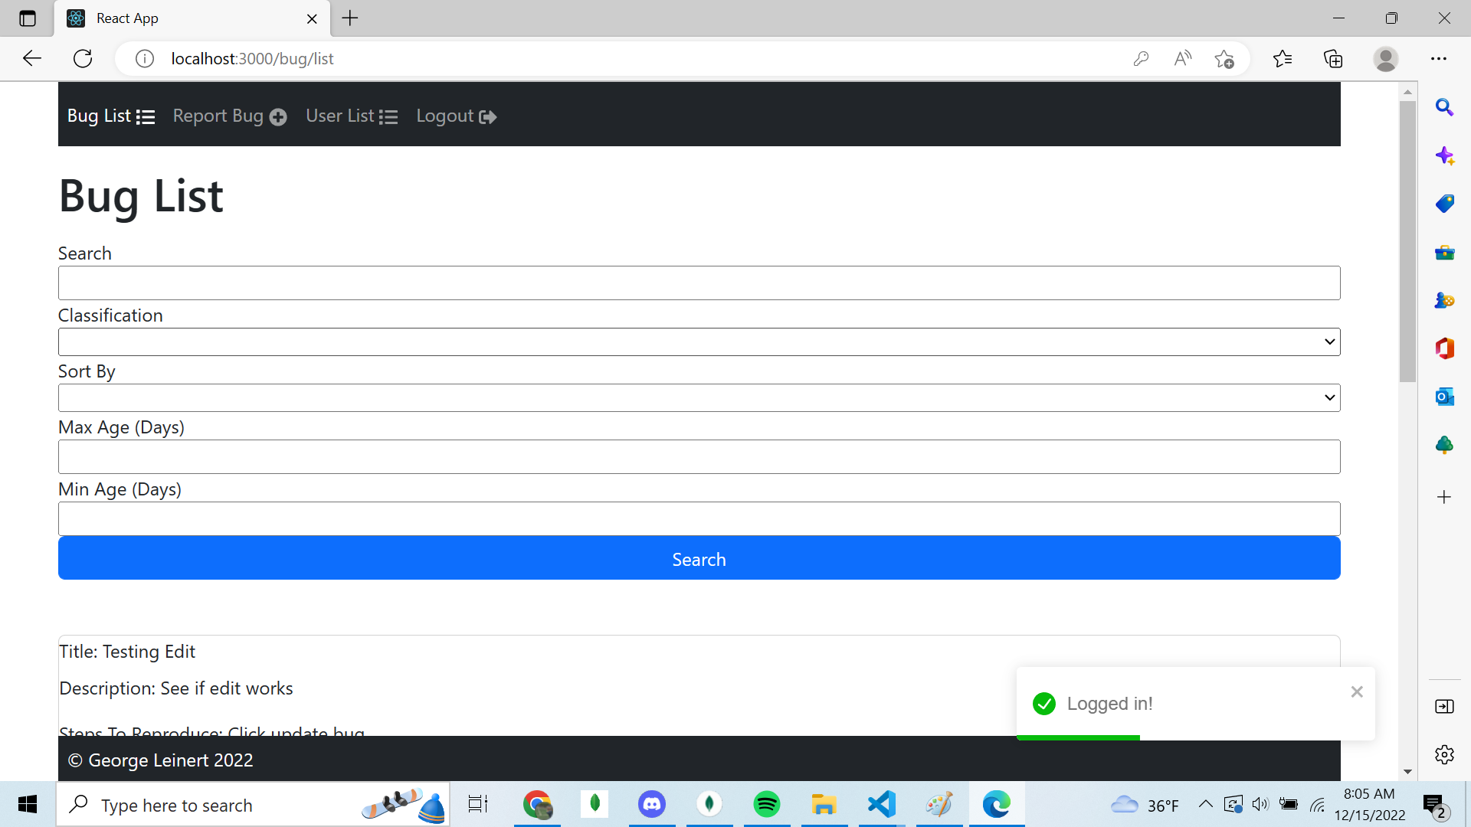
THE FRONT END

Slide 4
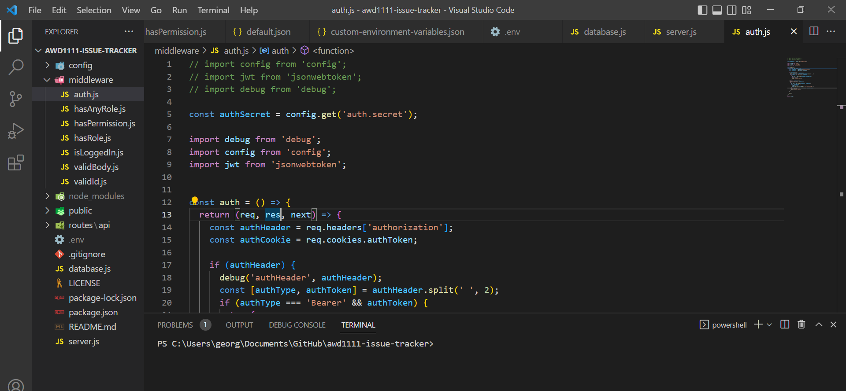
THE MIDDLE TIER

Slide 5
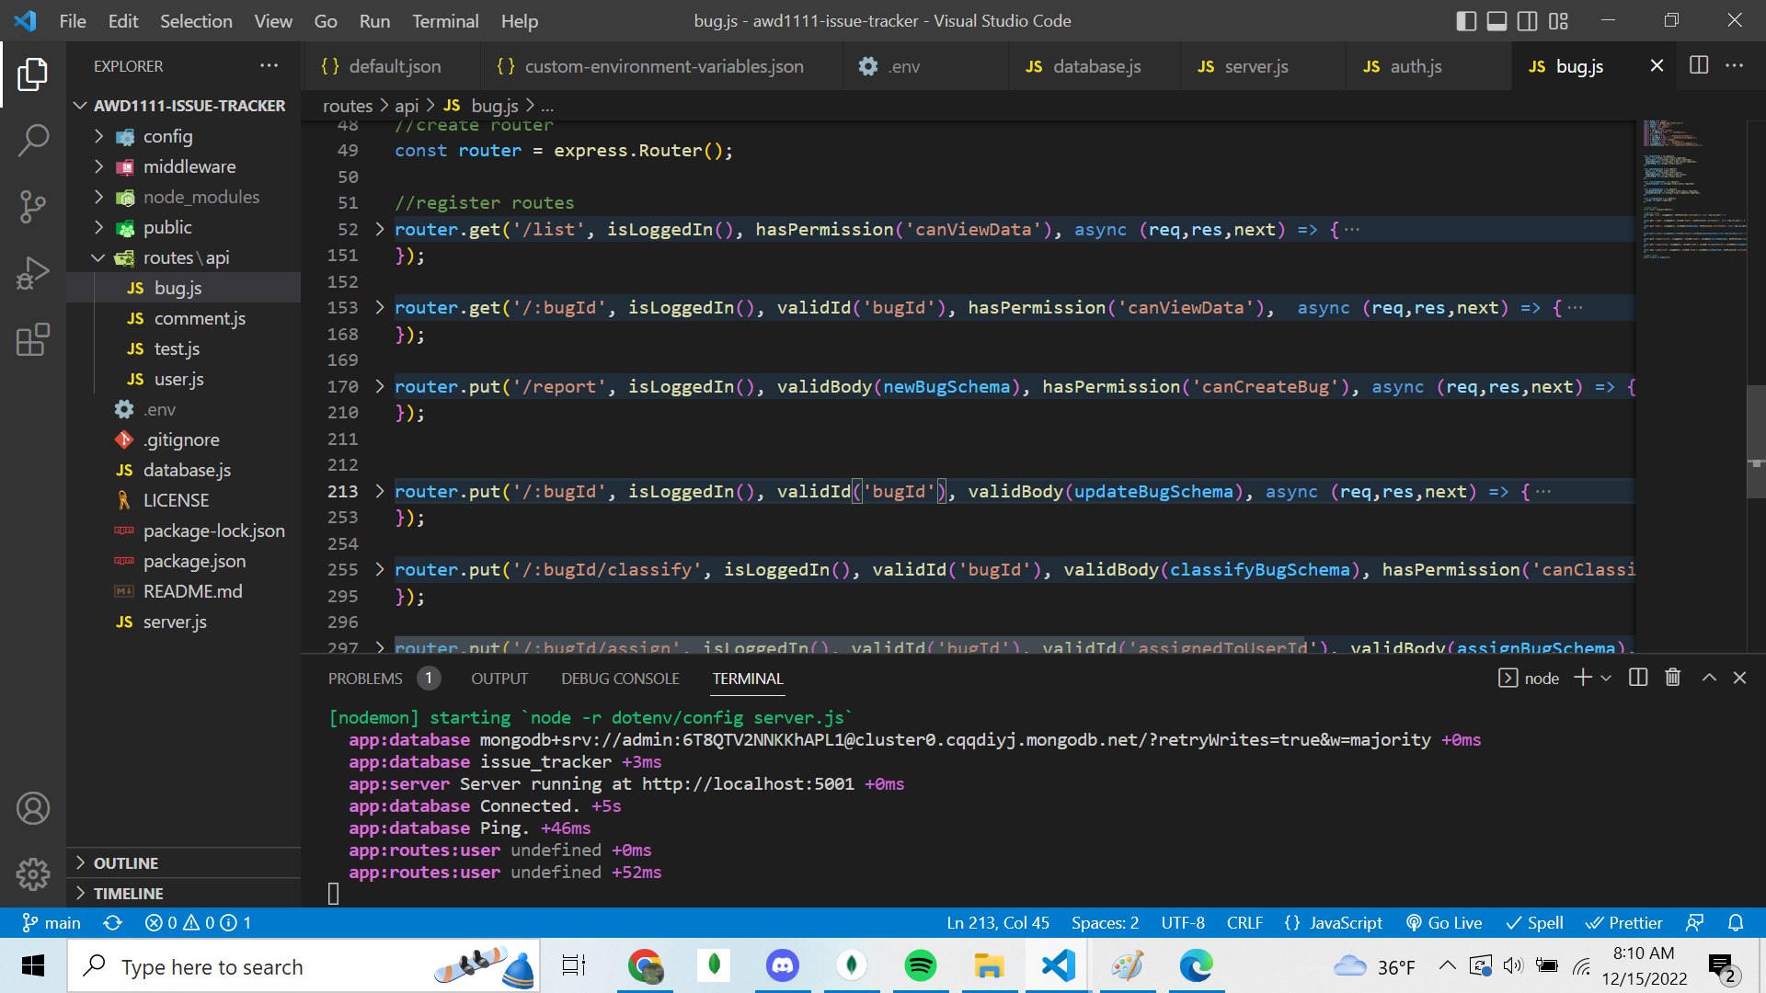
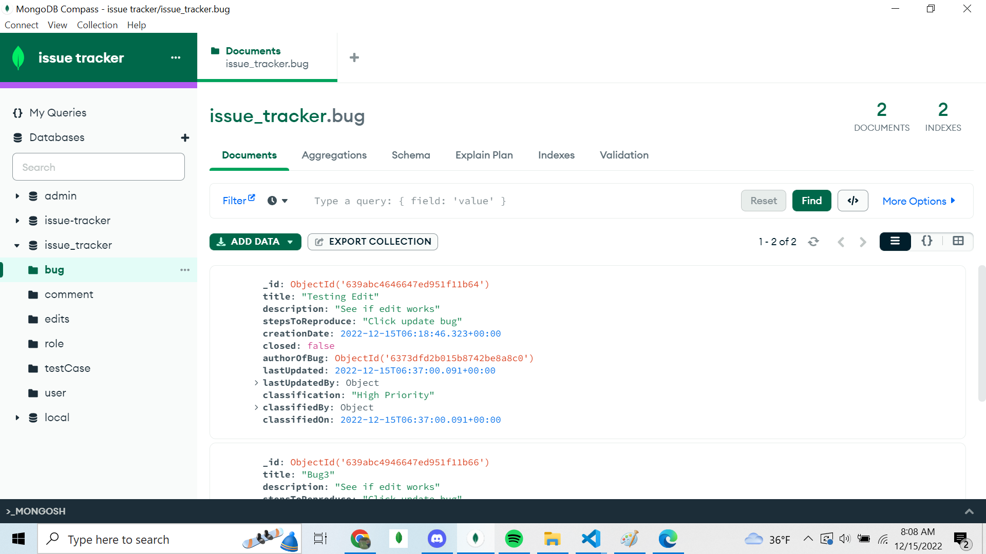
THE BACK END

Slide 6
THE BACK END

Slide 7
FEATURES
View a list of bugs and a list of users
Search and sort through the lists by name, date of creation, etc
Give users different roles
Edits users and bugs

